Slide 1

An case study on Virtual Memory Strategies
in Modern OS
Group 6

Slide 2
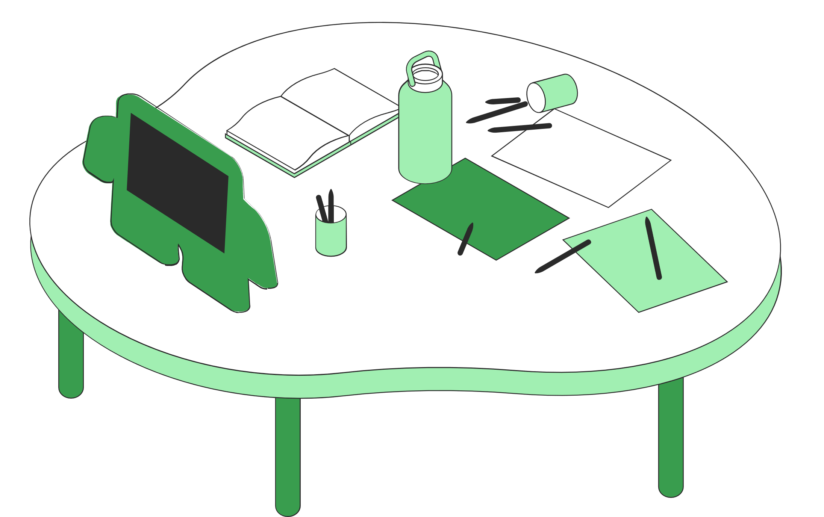
What is Financial Technology or FinTech?
Banking Before and After FinTech
A Brief history of FinTech
Challenges of FinTech
Rewards of FinTech-driven Payments
What's Next for FinTech?
FinTech 101
What to Know

Slide 3

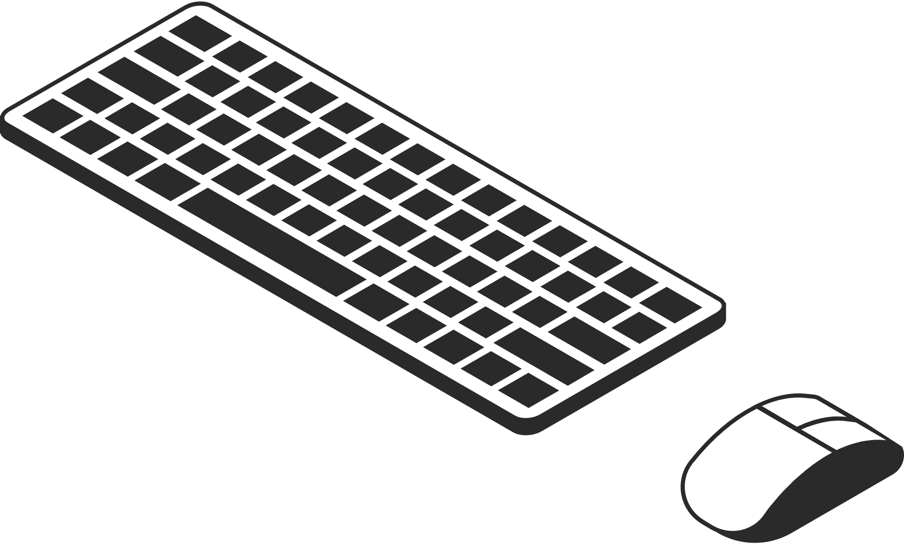
Introduction to Virtual Memory
Virtual memory is a memory management technique used by operating systems to simulate more RAM than is physically available. It allows programs to use more memory than is actually installed on the computer by temporarily transferring data from RAM to disk storage. This allows the computer to run programs that require more memory than is physically available, improving overall system performance.

Slide 4
Basic concepts of Virtual Memory
Virtual Address Space
Physical Memory (RAM):
Page Faults
Page Replacement
Address Translation
Occur when requested data is not in RAM, prompting retrieval from disk.
Mechanism to swap out pages from RAM when space is full.
Converts virtual memory addresses to physical addresses for data retrieval.
Each process sees a larger memory space than physically available.
Actual hardware where data and instructions are stored for immediate access.

Slide 5
Purpose of Virtual Memory
Expanded Address Space: Virtual memory allows programs to access more memory than is physically available in RAM. This is especially important for running large applications or multiple programs simultaneously, as it provides the illusion of a much larger memory space than what is physically installed in the system.
Isolation and Protection: Virtual memory helps in isolating processes from one another, ensuring that each process has its own dedicated memory space. This prevents one program from accessing or modifying memory allocated to another program, thus enhancing system stability and security.

Slide 6
Purpose of Virtual Memory (contd.)
Memory Management: Virtual memory facilitates efficient memory management by the operating system. It allows for dynamic allocation and deallocation of memory, as well as efficient use of physical memory resources through techniques such as demand paging and page replacement algorithms.
Virtual to Physical Address Translation: Virtual memory enables the mapping of virtual addresses used by programs to physical addresses in RAM. This translation is handled by the memory management unit (MMU) in hardware, or by the operating system if hardware support is lacking. It allows for efficient utilization of physical memory resources by storing only the most actively used portions of a program in RAM, while less frequently accessed data is stored on disk.

Slide 8

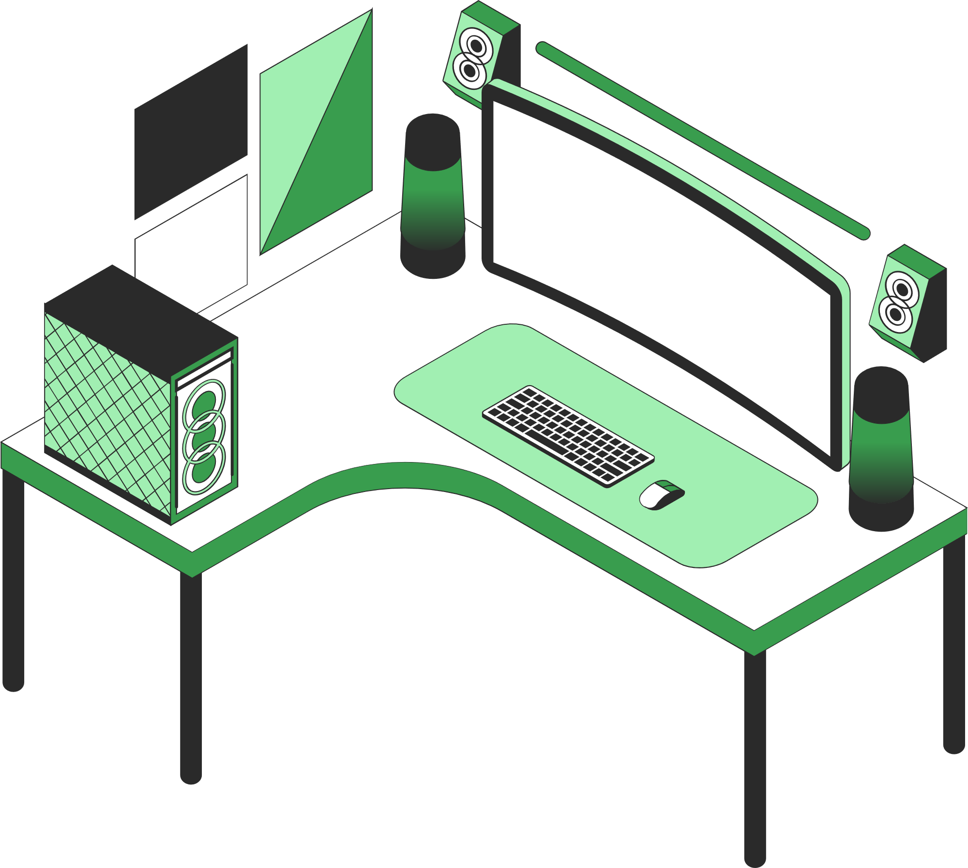
Virtual memory in modern OS
Modern operating systems play a crucial role in computing by providing a platform for applications to run and managing hardware resources efficiently. Resource Management, Security, Multi-tasking, File Management
Studying virtual memory strategies in modern operating systems is important for optimizing performance, managing resources efficiently, and enhancing system reliability and security.

Slide 9
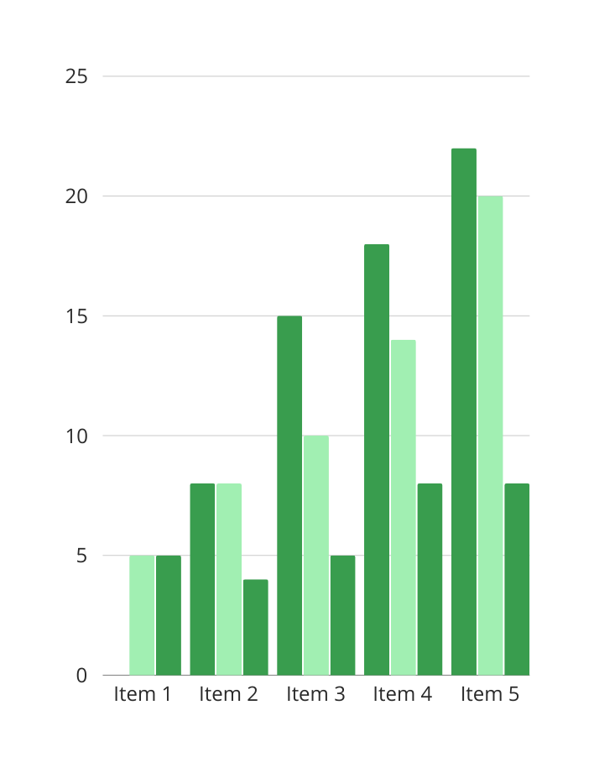
FinTech segments according to transaction value
As of January 2021
Digital payments are leading the way followed by personal finance, alternative lending, and alternative financing.

Slide 10

The Role of Cybersecurity
in FinTech
Protecting data is crucial
Because there's a lot of sensitive information involved in banking, cybersecurity is non-negotiable. Financial institutions must have robust cybersecurity measures to protect the data of consumers.

Slide 11

Challenges of FinTech

Slide 12
Where Fintech is now
Fintech-related Apps | Solutions They Offer
Payment Apps | These apps ease the payment experience of consumers and business owners alike
Investment Apps | These apps provide an easy and simple avenue for individuals to invest in stocks directly from your personal phones
Crypto Apps | These type of online apps allow individuals to use cryptocurrencies and tokens in transactions
Highlight two or more cells, right-click then choose "Merge Cells" to organize your table according to your needs!

Slide 13



Top Trending FinTech Risks
Dangers posed by FinTech to consumers
Money laundering risk
Online hacking
Digital identity risks
Regulations are yet
to be improved.
Hackers can gain access
to your accounts.
Security codes and passwords could be easily accessed.

Slide 14



Rewards
of FinTech-driven payments
Greater speed
Instant transfer of funds
Enhanced transparency
There's a clear trail of where money goes
Better security
A closer look at the benefits of
FinTech-powered payments
You can rest assured that your money
will not go astray

Slide 15

What's next for FinTech?
Looking forward to the future
Artificial intelligence and machine learning
will further infiltrate and improve FinTech.

Slide 16

FinTech has transformed the banking industry for the better.

Slide 17

Next-level data protection and encryption
Secure code and architecture
Secure authentication
Good mobile encryption
Compliance
Security best practices of successful FinTech projects

Slide 18


Financial institutions must be able to deliver an easy to navigate, a seamless digital platform that goes far beyond a miniaturized online banking offering.
Jim Marous

Slide 19
Do you have any questions?
Send it to us! We hope you
learned something new.

Slide 20





Whiteboard Page
Write a note here
Write a
note here
Tip: Collaboration makes teamwork easier! Click "Share" and invite your teammates to fill this up. Use this page for bulletins, brainstorms, and other fun team ideas.
Right-click on the background of the slide, or on the thumbnail below, for the option to expand this page into a whiteboard for more space!
Copy a note, drag to the board, and write your ideas.
Copy a note, drag to the board, and write your ideas.

Slide 21
Add even more sub-ideas
Add more sub-ideas
Add even more sub-ideas
Collaborate on a Whiteboard
Add a related idea
Add more sub-ideas
Add a main topic
Add a related idea
Add a related idea
Tip: Collaboration makes teamwork easier! Click "Share" and invite your teammates to fill this up. Use this page for bulletins, brainstorms, and other fun team ideas.
Right-click on the background of the slide, or on the thumbnail below, for the option to expand this page into a whiteboard for more space!
Add a related idea
Add more sub-ideas
Add even more sub-ideas
Add more sub-ideas
Add even more sub-ideas

Slide 22



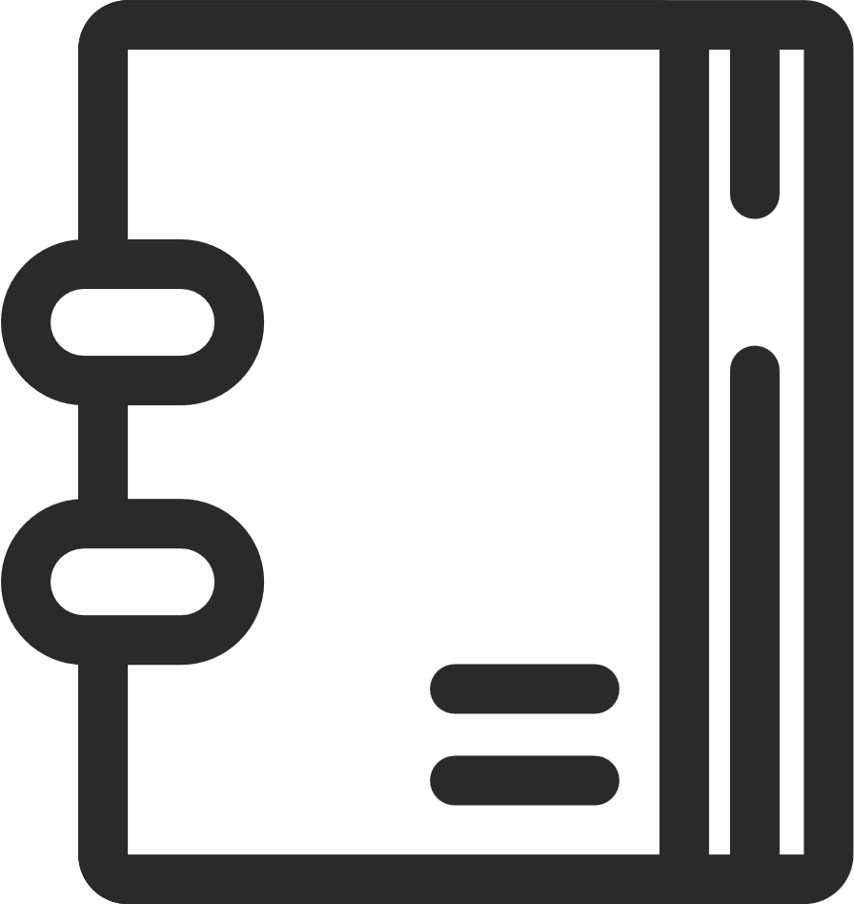


























Resource Page
Use these design resources in your
Canva Presentation. Happy designing!
Don't forget to delete or hide this page before presenting.

Slide 23
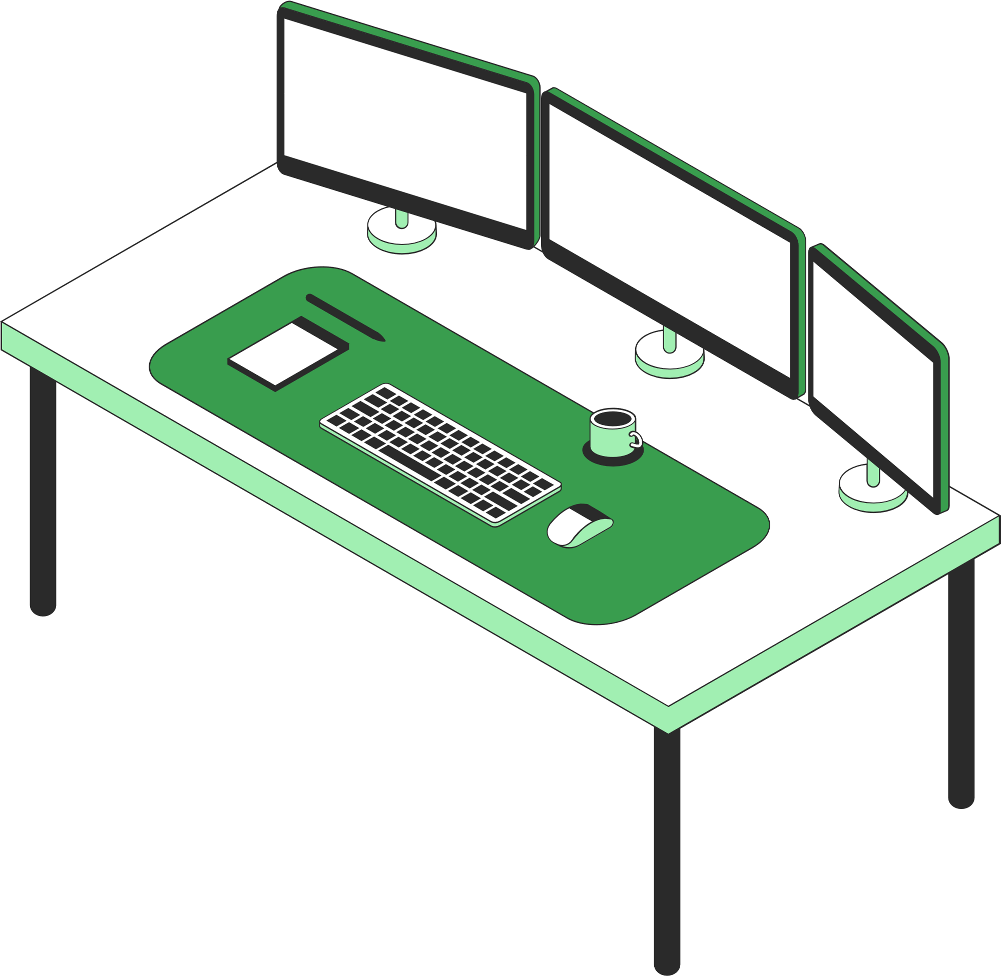


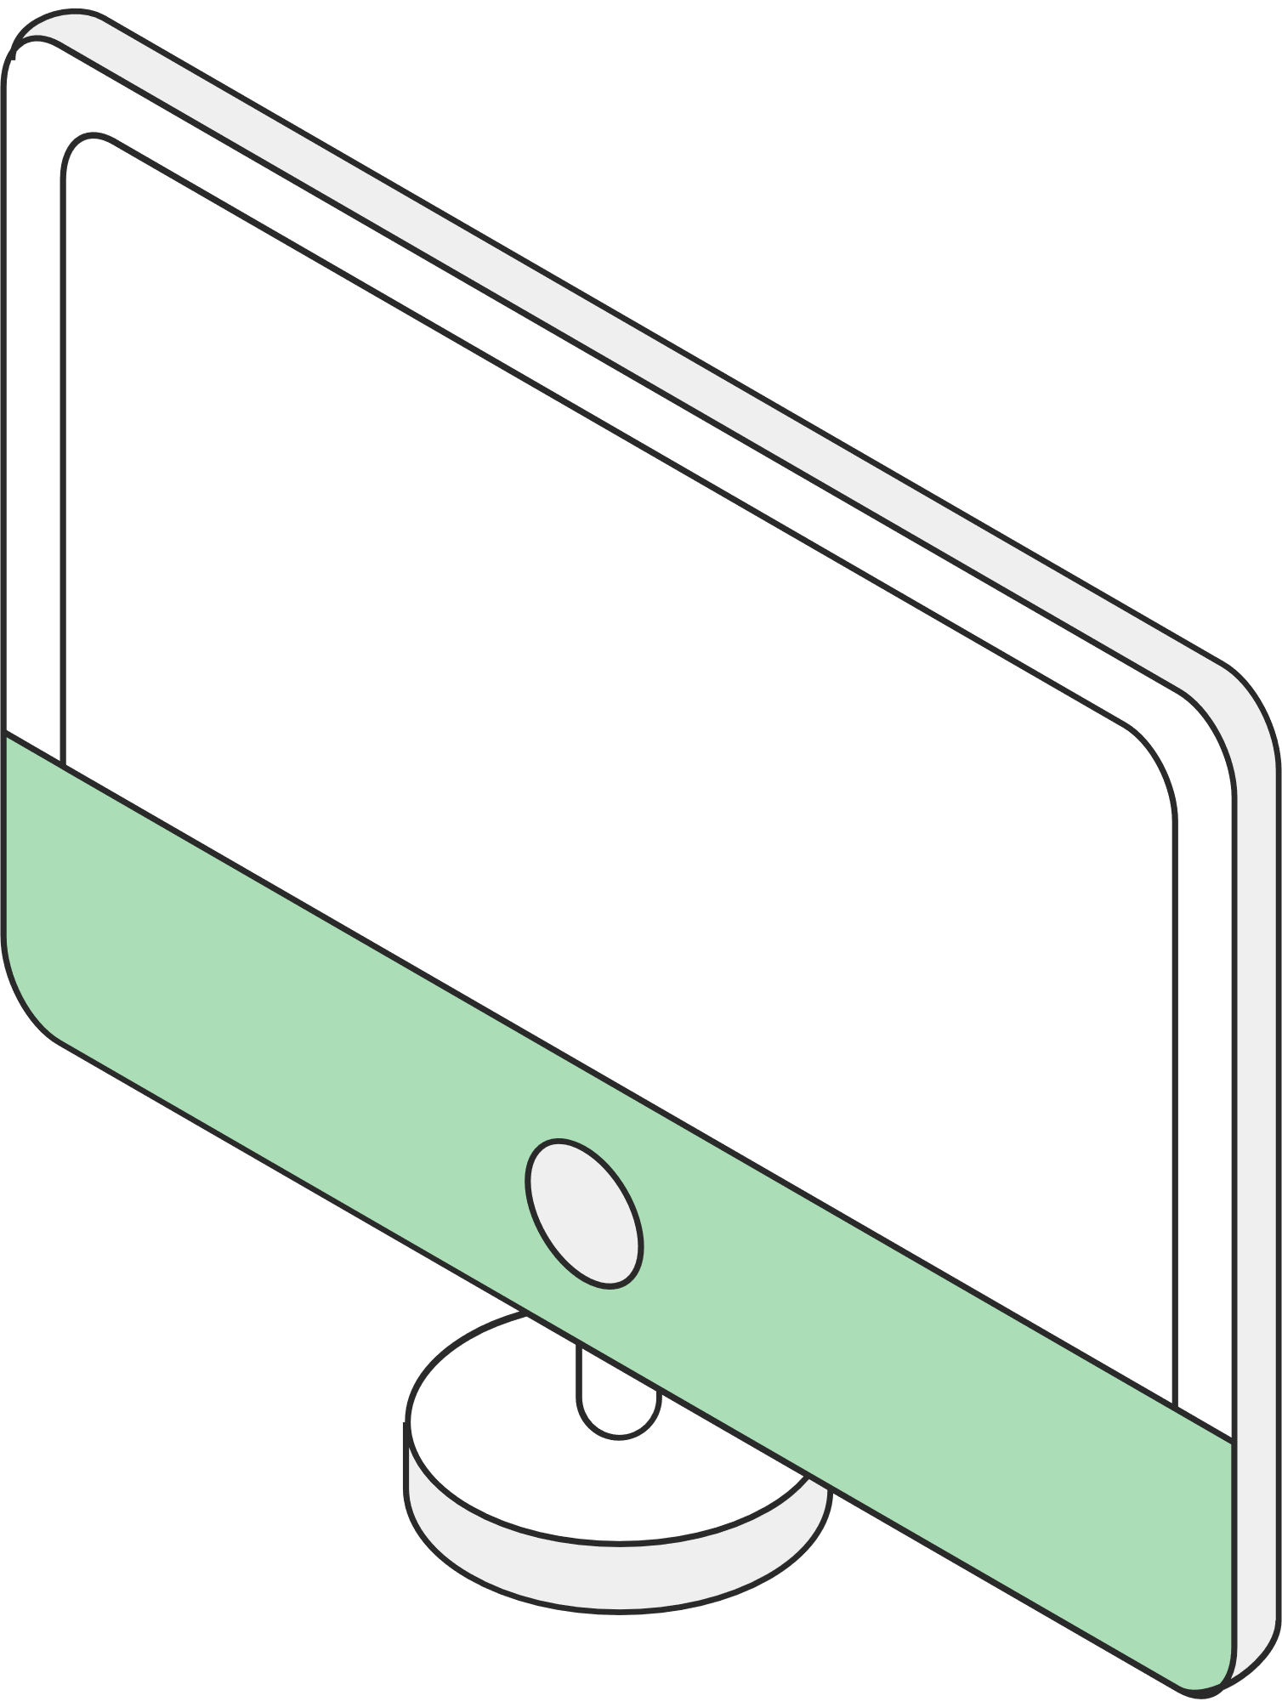
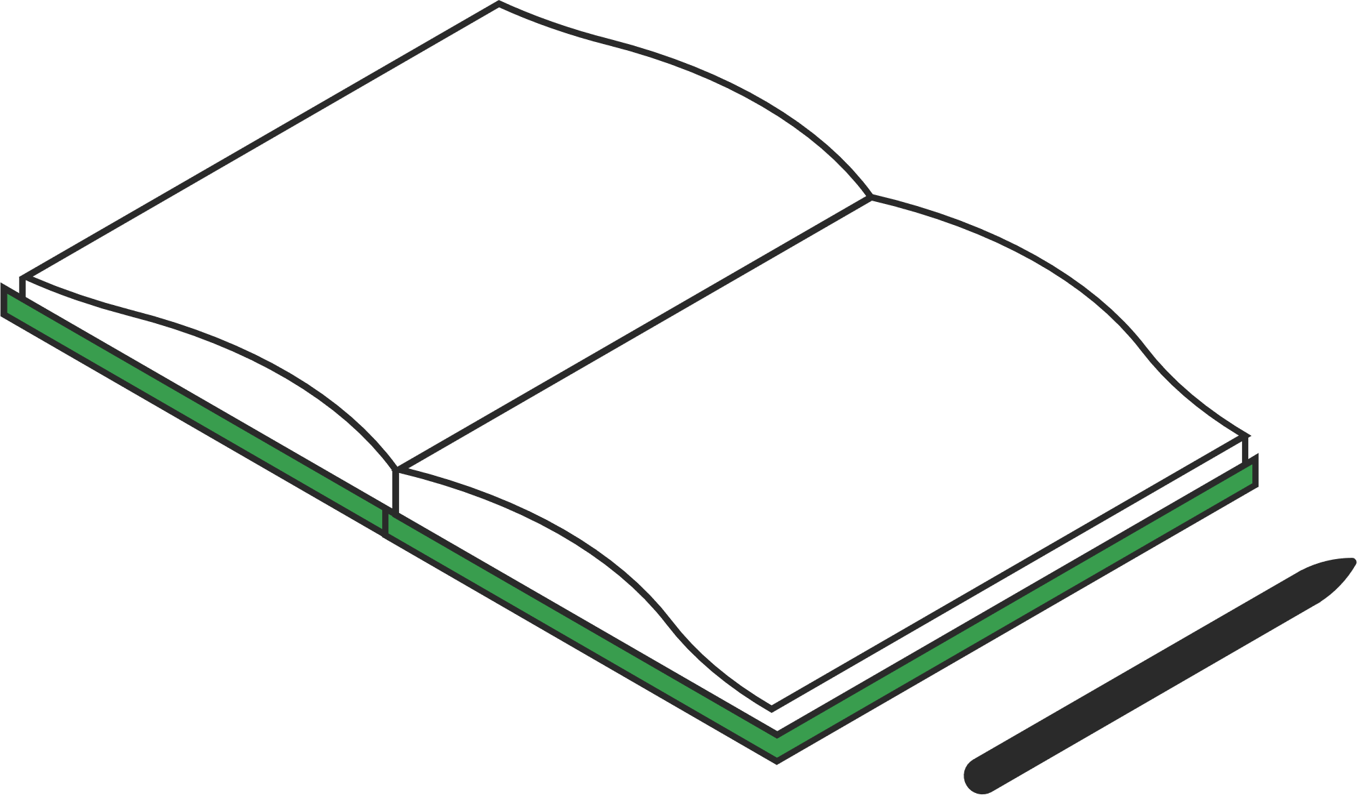

Resource Page
Use these design resources in your
Canva Presentation. Happy designing!
Don't forget to delete or hide this page before presenting.

Slide 24











Resource Page
Use these design resources in your
Canva Presentation. Happy designing!
Don't forget to delete or hide this page before presenting.

Slide 25
B for blur | C for confetti
D for a drumroll | M for mic drop
O for bubbles | Q for quiet
U for unveil | Any number from 0-9 for a timer
Resource Page
Find the magic and fun in presenting with Canva Presentations. Press the following keys while on Present mode!
Delete or hide this page before presenting.

